Slide 1



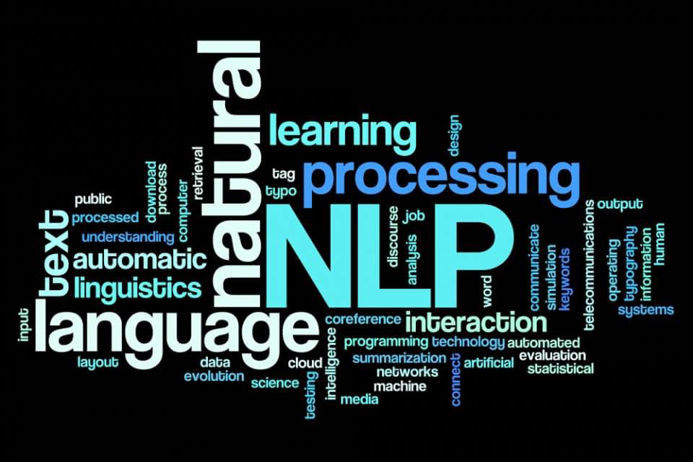



DEPARTMENT OF COMPUTER ENGINEERING AND INFORMATICS
UNIVERSITY OF PATRAS
Course:
Big Data Management and Mining Methods
Professors: Makris Christos
Mpobotas Agorakis
Sparknlp Project for job postings Classification
Presenter: Evangelos
Geraridis
Date: 04/07/2022

Slide 2

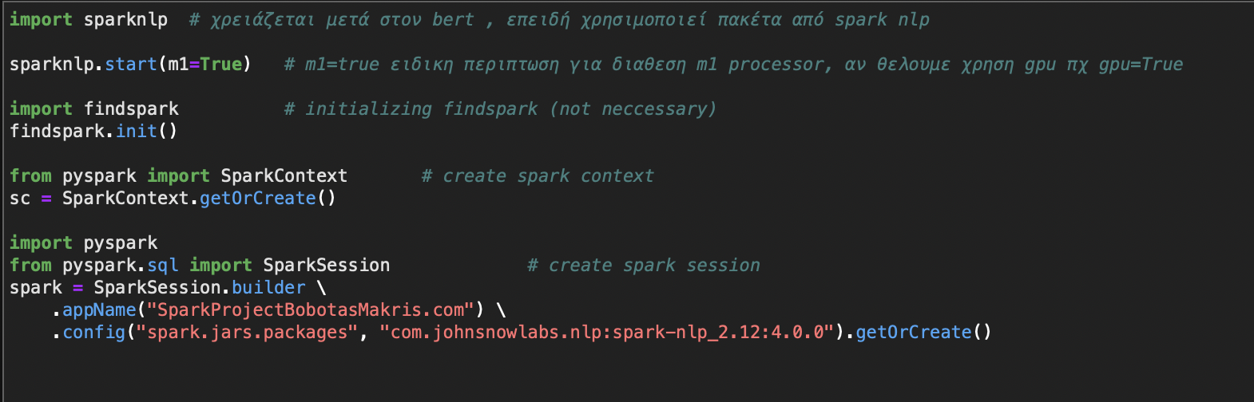
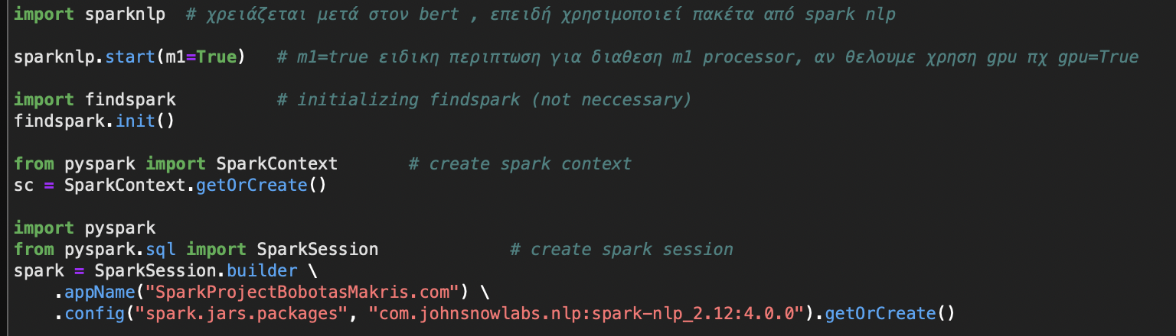
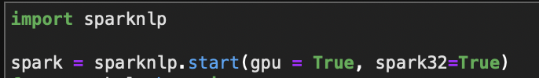
INITIALIZATION:
JUPYTER NOTEBOOKS:
GOOGLE COLAB NOTEBOOK:

Slide 3
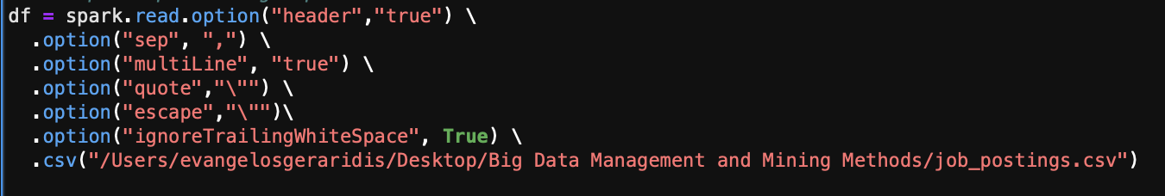
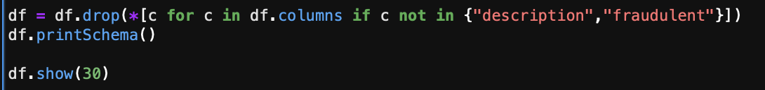
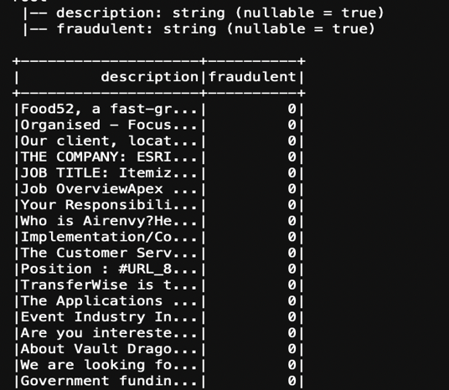
LOAD DATASET AND PREPROCESS:
REMOVE THE UNWANTED COLUMNS:

Slide 4
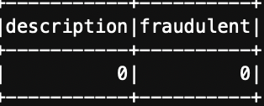
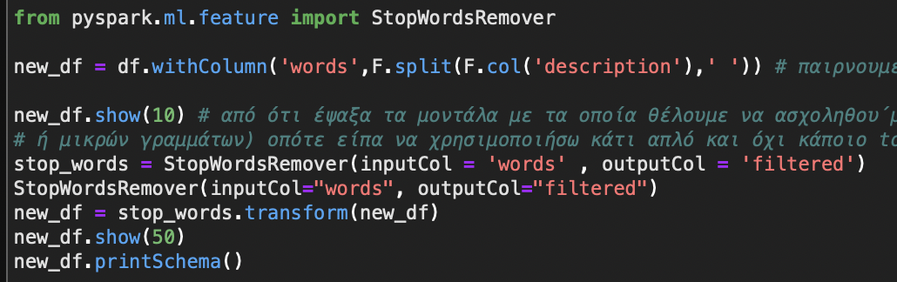
DO WE HAVE MISSING VALUES?
NO →
Word2Vec (not used for classification):
We begin by removing stopwords with StopWordsRemover from pyspark ml feature:
Since the input column must be words and not sentences or phrases, we use the pyspark sql function split to split the description columns text to words.

Slide 5
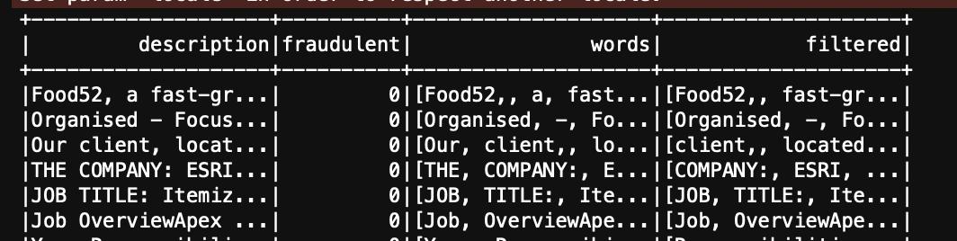
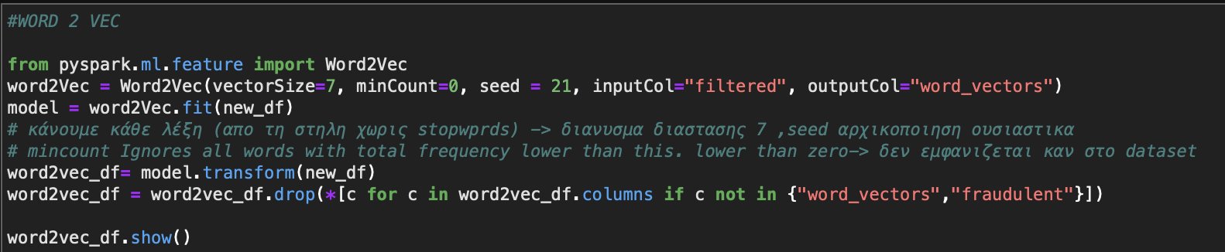
Word2Vec (not used for classification):
←The new df with the removed stopwords looks like this
Word2Vec → each splited cleaned word becomes a 7 dimensional vector:

Slide 6
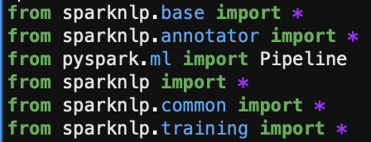
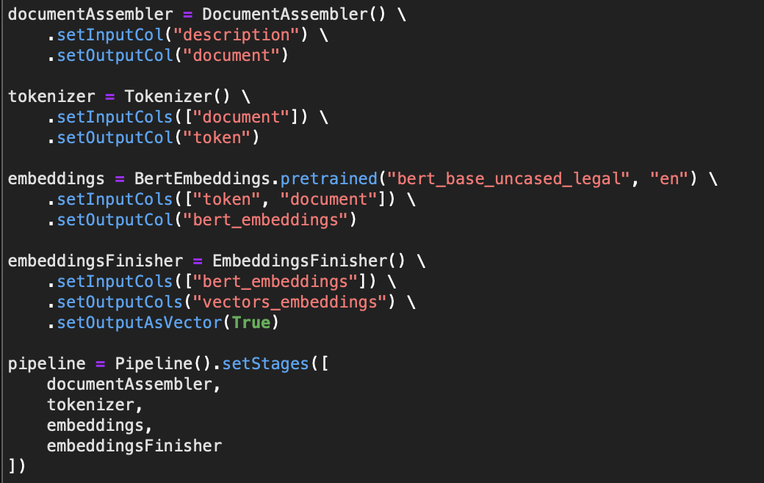
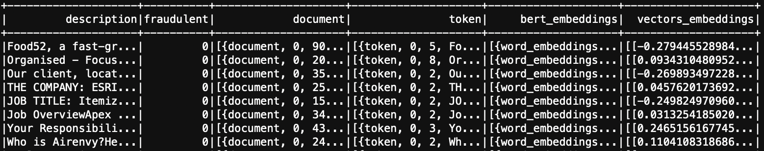
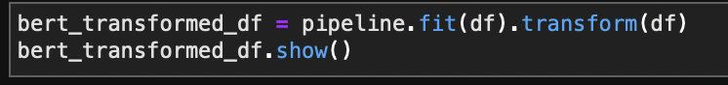
ALTERNATIVE WAY TO TRANSFORM EACH WORD TO A VECTOR, USING BERT_BASE_UNCASED_LEGAL:
← Imports
<-- Prepares data into a format that is processable by Spark NLP.
←Tokenizes raw text in document type columns into TokenizedSentence .
<-- Pretrained model creates the bert embeddings (dense vector representations) for nlp.
transform embeddings to vectors.
← Way of designing the model.
→

Slide 7
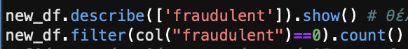
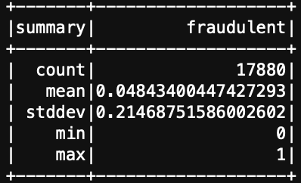
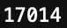
MODELS THAT WERE USED FOR CLASSIFICATION WITH CLASSIFIERDL:
Before we dive in, what should we expect?
→ Is our dataset balanced?
(PySpark Sql functions needed)
The mean of fraudulent is very close to zero.
17014 out of 17880 entries belong to the zero fraudulent class, more than 95% !
Big dataset impalance!
We expect our models to be biased.

Slide 8
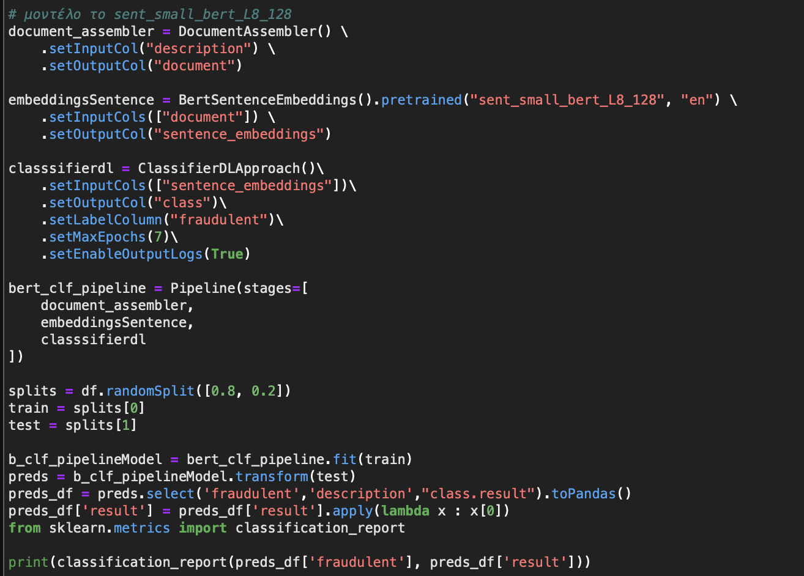
BERT SENTENCE EMBEDDINGS FOR JOB POSTINGS CLASSIFICATION USING CLASSIFIERDL:
Same imports we used for bert embeddings (word to vector transformation).
Same as before
Whole Sentence embeddings
Trains a ClassifierDL for generic binary Text Classification (in our project 0 or 1, could be used for multiple classes. It uses a deep learning model built inside TensorFlow.
We use scikit learns classification report which gives us all the requested metrics to measure and compare our models.

Slide 9
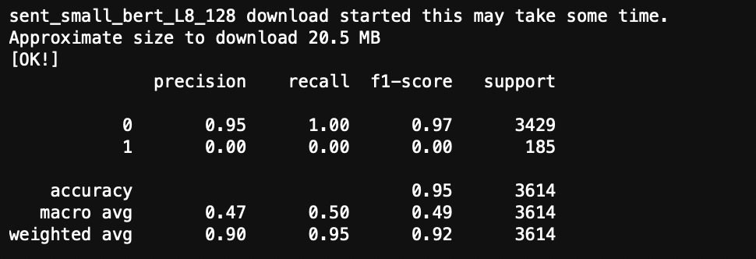
Bad results!
What do these metrics measure?
Precision: What percent of the predictions were correct? (how good is the model at predicting a specific category)
Recall: Percentage of correct positive predictions relative to total actual positives.
F1 Score: A weighted harmonic mean of precision and recall.
Accuracy: How many predictions were right?
Support: # actual occurrences of the class in the specified dataset.

Slide 10
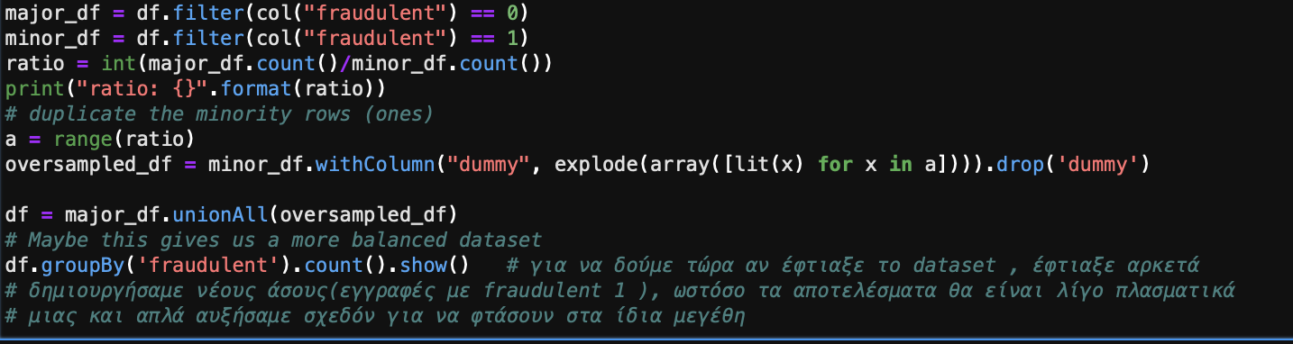
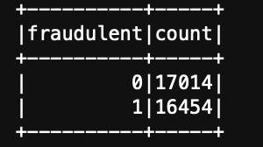
OVERSAMPLING ON BERT SENTENCE:
We check how many entries belong to zero and one fraudulent class respectively →

Slide 11
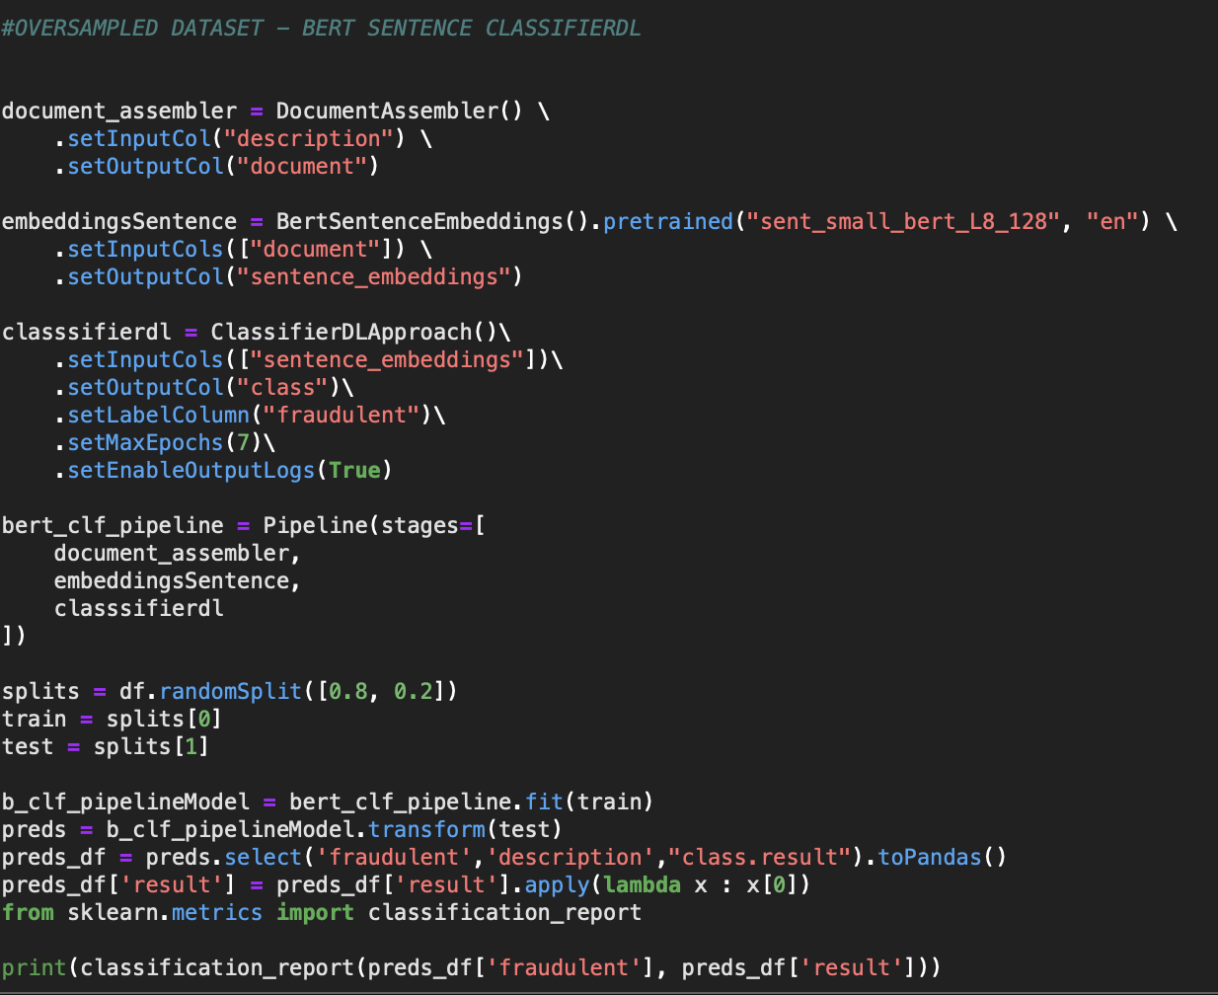
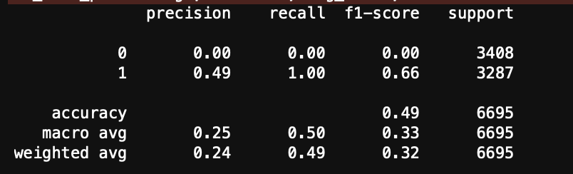
← SAME PROCESS
←Unexpected results since now we had a balanced dataset, no zero class was predicted right.
Worse results since the model is not accurate at predicting one class at least .

Slide 12
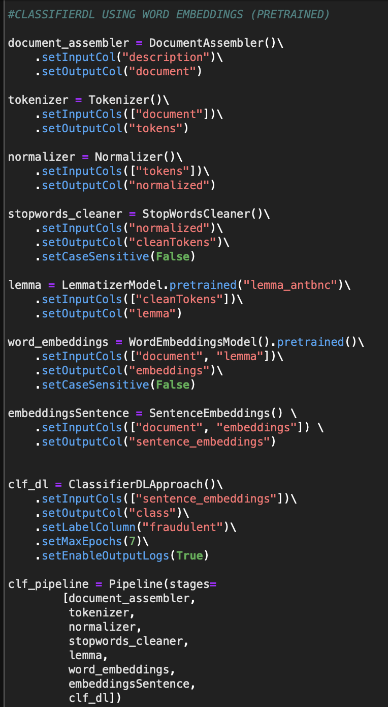
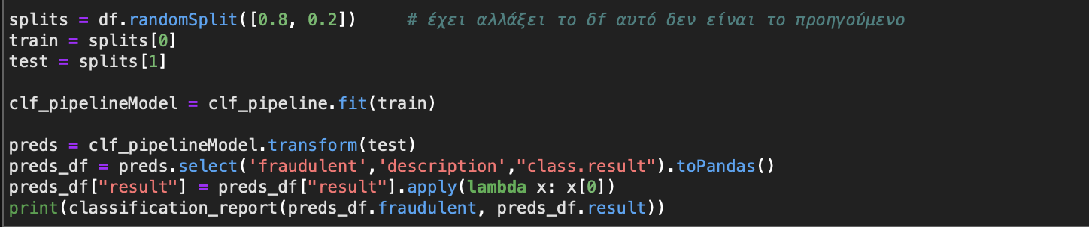
CLASSIFIERDL USING WORD EMBEDDINGS:
cleans out tokens.
drops all the stop words from the input (normalized tokens here).
Retrieves the significant part of a word.
maps tokens to vectors (here both the document and the lemmas)
Converts the word embeddings to sentence embeddings

Slide 13
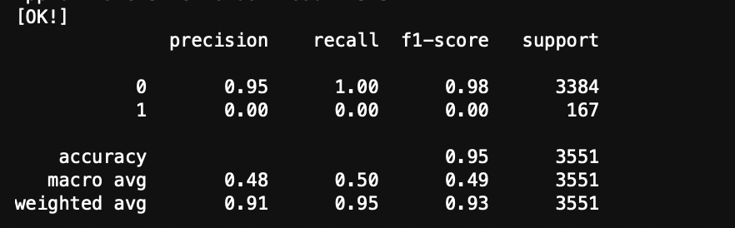
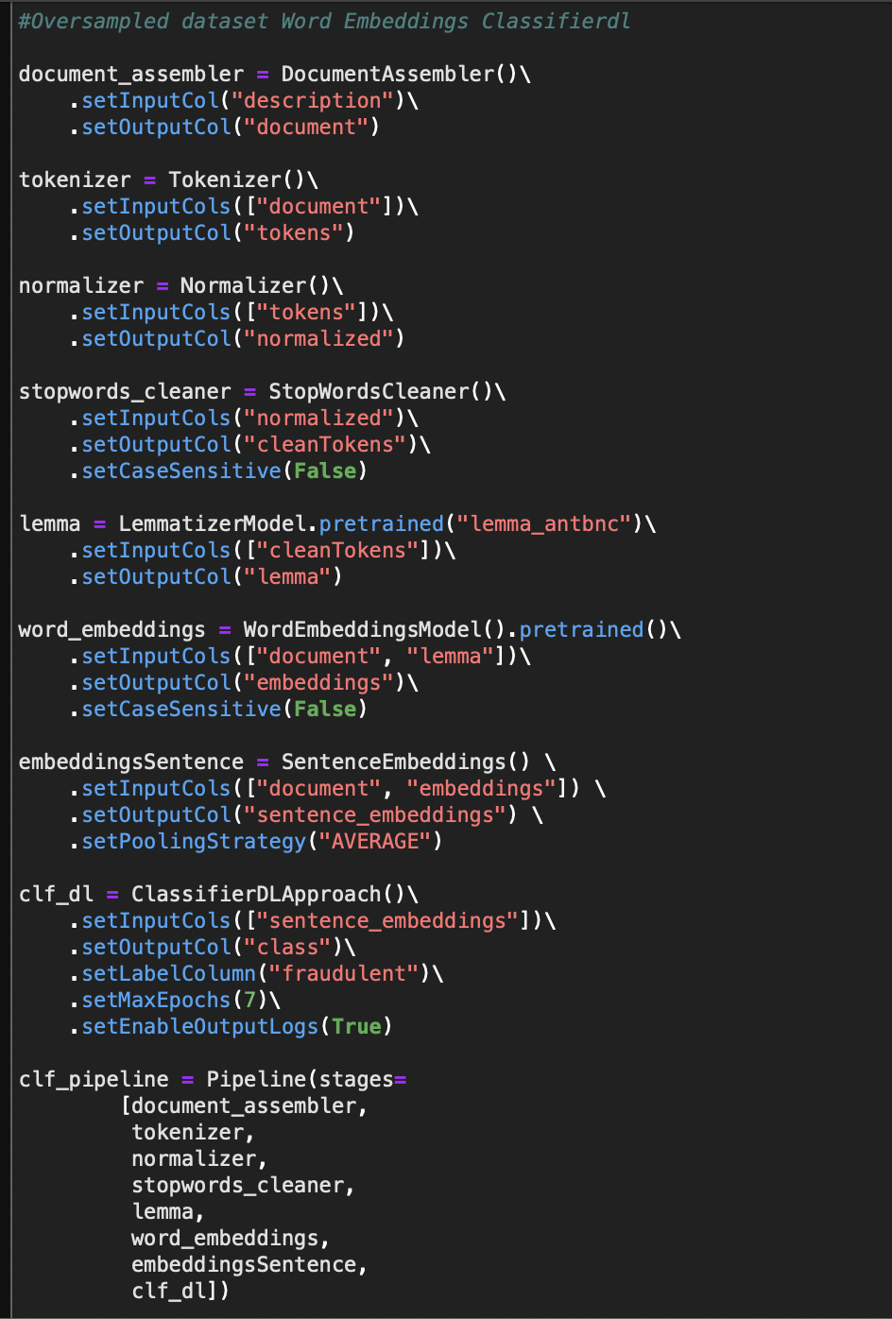
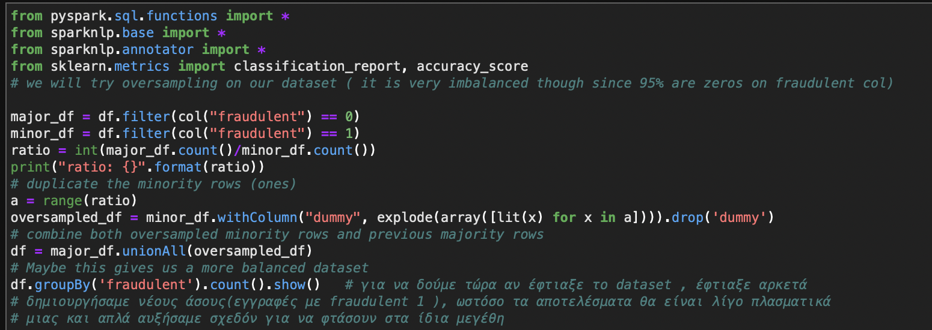
Simmilar results to bert sentence embeddings on the original dataset
What if we used oversampling?
Same pipeline →

Slide 14
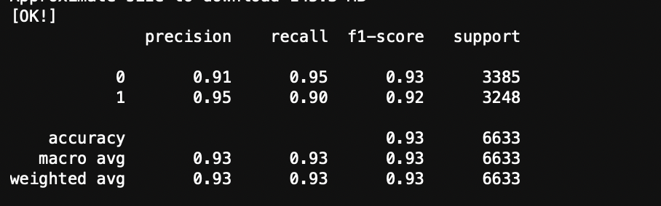
Better results!
Our model here predicted with great accuracy, recall precision and f1 score the labels for each class!
For the given oversampled dataset our model did a great job
Dangers could occur when real world data would get classified,
since they might be imbalanced just like the orginal dataset…

Slide 15
CONCLUSIONS:
Given our results our models did not provide good classification results
for our given datasets.
Our Word Embeddings model using the classifierdl on the oversampled
dataset provided the best results of all.
These results actually seem great at first glance, but this does not mean
that this model will provide such good results on real world datasets.
In simpler terms the last model almost certainly overfits (our model fits exactly our oversampled training data.
If we were to chose one we would go with the last one but we should
proceed with caution and test it in different datasets, preferably real
world ones.
Undersampling most probably will not work too, since it could create a problem of information loss which might lead to poor model training.

Slide 16
FUTURE WORK:
A very simple answer would be to gather more data
Removing data that are duplicated
Convert the given english text to any other random language and then using a neural machine translation, convert it back to english.
Data augmentation for text: Tokenize a document to a sentence, then shufle the tokens and generate new text. Adjectives, verbs, noun e.t.c will be replaced with simillar worlds to generate different text with the same meaning.

Slide 17
REFERENCES:
https://nlp.johnsnowlabs.com/docs/en/install
https://nlp.johnsnowlabs.com/docs/en/annotators
https://towardsdatascience.com/how-i-handled-imbalanced-text-data-ba9b757ab1d8

Slide 18
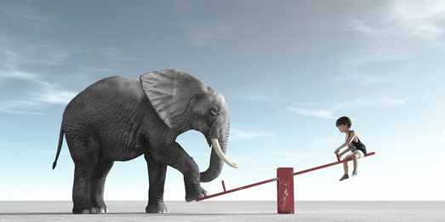
THANK YOU FOR ATTENDING!!

